Slide 1
Web Scraping: Spotify Music Charts
By Nick Iudiciani & Altamas Kadawala

Slide 2

Purpose
We will extract different datasets from Spotify’s top songs charts, such as regional subsets, daily or weekly or all-time streams, and top 200 + viral 50 charts.
Songs are ranked based on number of streams, and even show a trend icon for how the song is performing within the current list (won’t be used in the code, however).

Slide 3

Methods
Develop a web crawler that will retrieve the data that we need
We want to reference the Jsoup library sufficiently in Eclipse to extract proper table rows and data into a .csv file

Slide 4
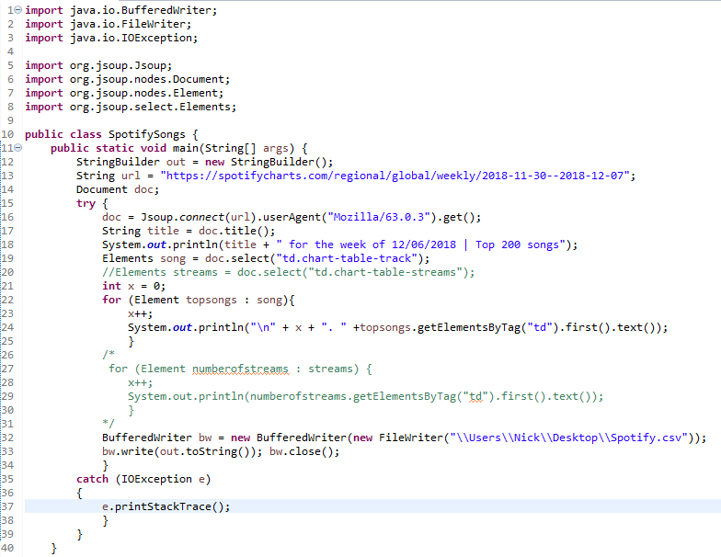
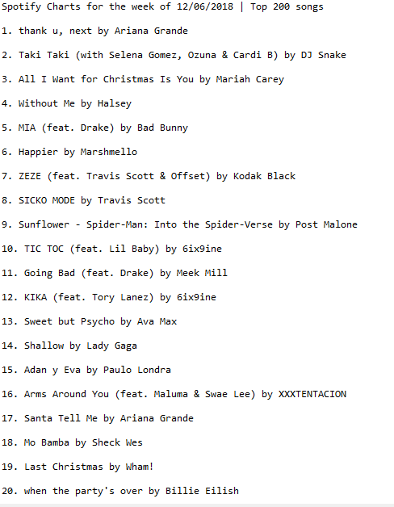
Current Progress

